Slide 1
Landmarked

Slide 2
Algorithm Refinement
Figure out Line of Sight
Calculate boundary box
Ensure within field of view

Slide 3
File Refactor
Removing unused files
Wrapping like classes into packages

Slide 4
User Database Storage
Updating ER Diagram to include Users
Minor changes to existing ER to incorporate Users
Implement change into Database

Slide 5
Azure Cloud Database Connection
Set up connection class to SQL database
Stuck on Connection String

Slide 6
Azure Cloud SQL server
Fixed connection string
Fixed JDBC driver
Wrote methods to insert our data
Wrote methods to retrieve our data
Made our Cloud SQL operations threadsafe, much like our local SQL

Slide 7
Buttoning up local SQL
Finished writing methods to store and retrieve on the local device
Easy, convenient communication between Cloud and Local storage
Most importantly, persistence

Slide 8
Refactoring numerous landmark classes for consistency
LocalLandmark
CustomLandmark
CustomLocalLandmark
Etc…. etc...

Slide 9
Refactoring numerous landmark classes for consistency
Each landmark is a table in our local DB
Can’t use one standard Landmark class since they are coming from different sources, handled differently
Still, standardized data, added getters for easy access
Data can be transferred between the classes seamlessly

Slide 10
Bug fixes
Still one large bug with the way we log in
Static instance variables for navigation through app
(changing view rather than changing activity)
Removing old relics and artifacts that had no clear purpose

Slide 11
Landmark Filtering
Need relevant results to user
Natural: Mountain, lakes, rivers, etc
Man-made: Monuments, bridges, dams, etc
Problems:
No standardization among types
Multiple layers of filtering
No filter can be exact

Slide 12
Landmark Filtering Approaches
Proximity-based (last sprint)
Proximity-based w/query
Boundary Box
Boundary Box w/Algorithm

Slide 13
Proximity-based
Presents results near you with only extremely broad type filters to prevent anything but places/points of interest from showing up.
E.g. No roads
Advantages:
Easy, simple, and effective at a broad filter level
Challenges:
Hope results are relevant
Can’t guarantee the results will be in front of the user

Slide 14
Proximity-based w/Query
Same as Proximity-based, but with a search query.
Similar to typing “Lake near me” in Google Maps
Advantages:
Likely to get a “lake” or alternative landmark as first result
Challenges:
Lose some ability to distinguish between types of results
E.g. “Lakeview Street” can show up as a result

Slide 15
Boundary-Box
Sets a hard limit to results from a predefined boundary box
Advantages:
Guarantees that all results will be within the boundary box
Can still use a search query to “somewhat” limit results
Challenges:
Heavy involvement from Junmin and his algorithm
Can only set boundary boxes parallel to latitude & longitudinal lines
Polygon results (aka a lake) are largely excluded unless their “center point” is within the box.
As most Landmarks are polygons, this approach isn’t very useful.

Slide 16
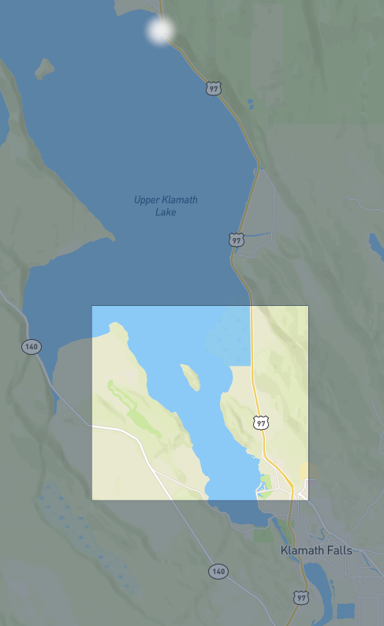

Slide 17
Next Solution - Boundary Box + Algorithm
Large Boundary Box in front of user
Gather all of the Results
Check if Polygon results are within a smaller “Boundary Box” filtered within the larger Boundary Box.

Slide 18
MediaWiki API
Used to get information from Wikimedia Foundation Projects
Plan to use to gather information about Landmarks from Wikipedia
Some results returned from MapBox have a Wikidata ID
Potential to get some category information from there, but not guaranteed

Slide 19
Changing our app navigation
Previously, just changing the view to navigate to a new area of the app (new or different screen)
Different classes need to call the same methods
Added static instances of activities
Can easily get an instance to call a method from
Fixed a lot of problems, especially with listeners

Slide 20
Refactoring Strings
Tasked to localize all strings
Can reuse previously used strings
Ex:
Landmark
Latitude
Longitude
Elevation
Still have to consider the time to concatenate multiple strings

Slide 21
Why Localize Strings?
Technically we can now utilize Android Studio’s translation editor
Stretch Goal 2021
Memory considerations
“Why is Landmarked taking up 2.56 GB?” (hasn’t happened...yet)

Slide 22
Transfer Landmarks via ArrayList
Allows us to pass more than 1 Landmark into an Activity
Now we can pass in a full Mapbox query or multiple queries with one object
Elements in the list are now sortable, so we can sort things by…
Date visited, for history
Name, for Custom Landmarks
Elevation
Landmark type, lakes vs. mountains

Slide 23
Change the UI
“Make it not look like a generic android app”

Slide 24



Slide 25
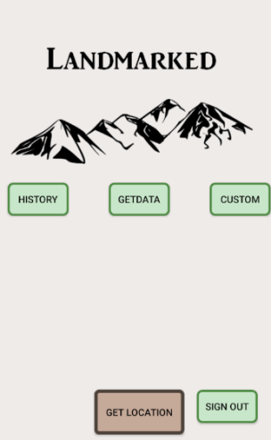
End Result
Edited the button design
Added a space above our logo for when user’s sign in
Shared preferences for what settings the user has
i.e. Map View vs. List View

Slide 26
DEMO TIME

Slide 27
QUESTIONS

